Slide 1

Lesson 4: Homework Review

Slide 2
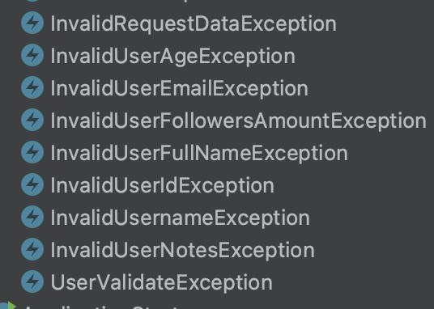
Create exceptions for process and not for each field

Slide 3
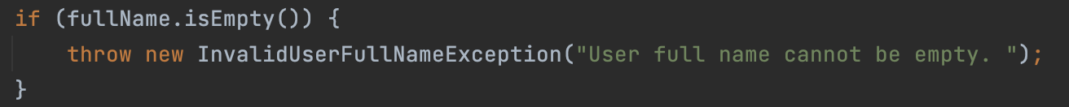
Don’t forget about Whitespaces (" ")

Slide 4
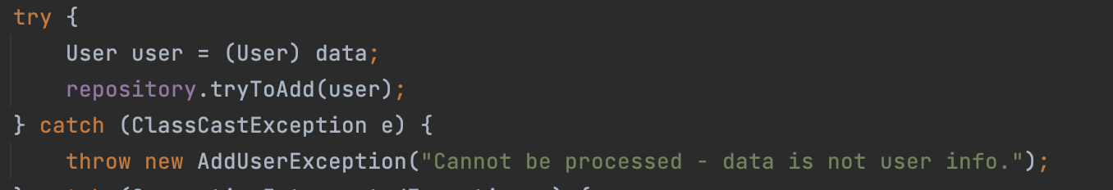
Cast class correctly

Slide 5
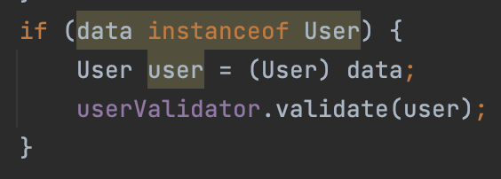
Cast class correctly

Slide 6
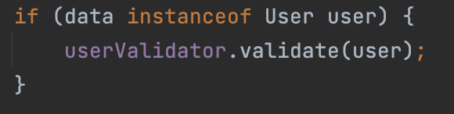
Cast class correctly

Slide 7
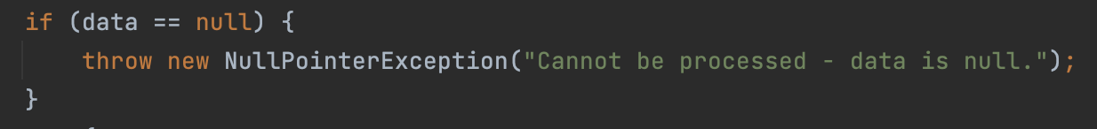
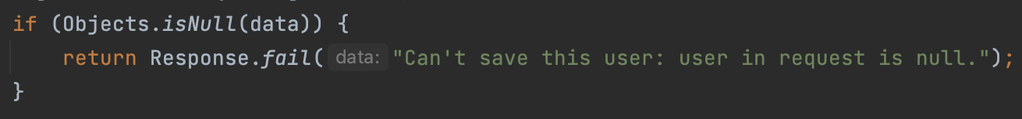
Handle nullpointer exception instead of producing it

Slide 8
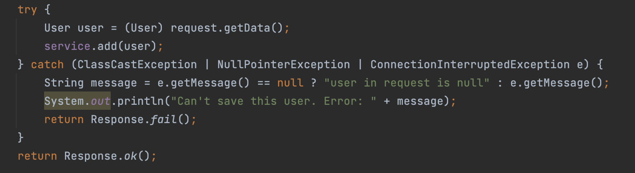
Find the problem

Slide 9
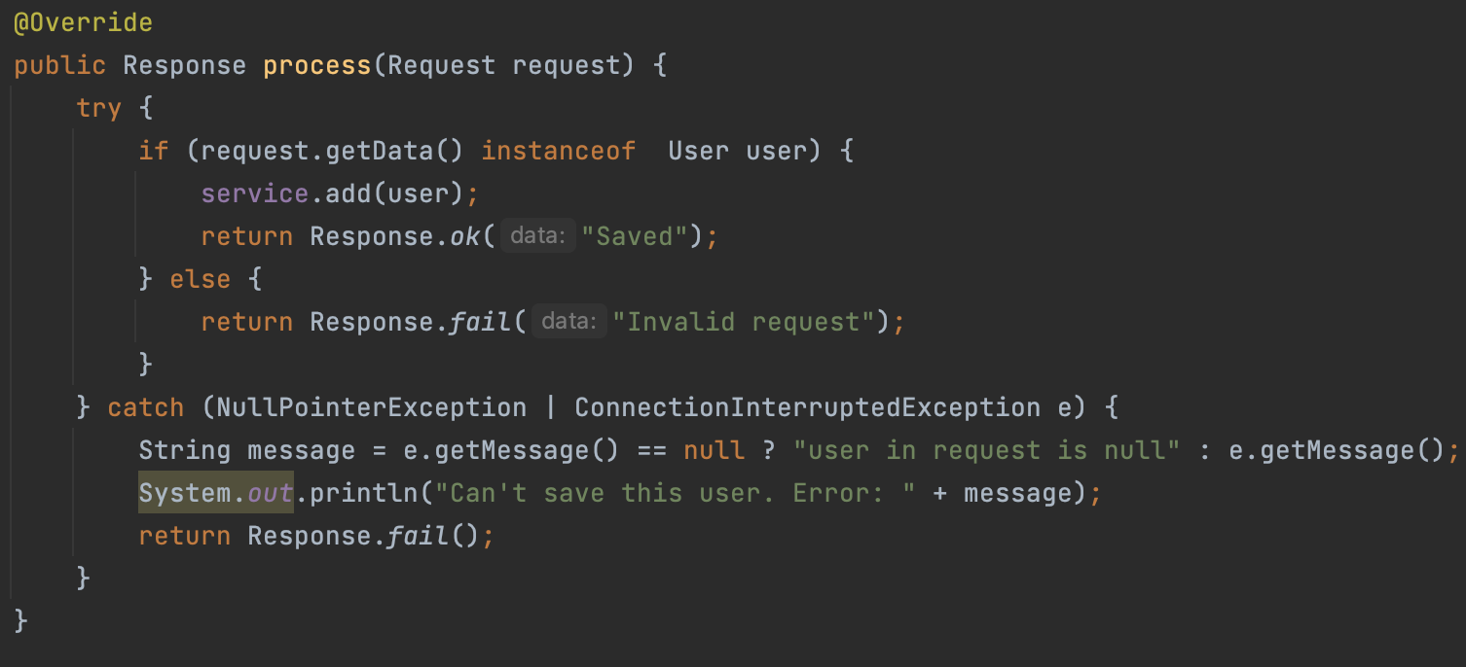
Fix the problems

Slide 10
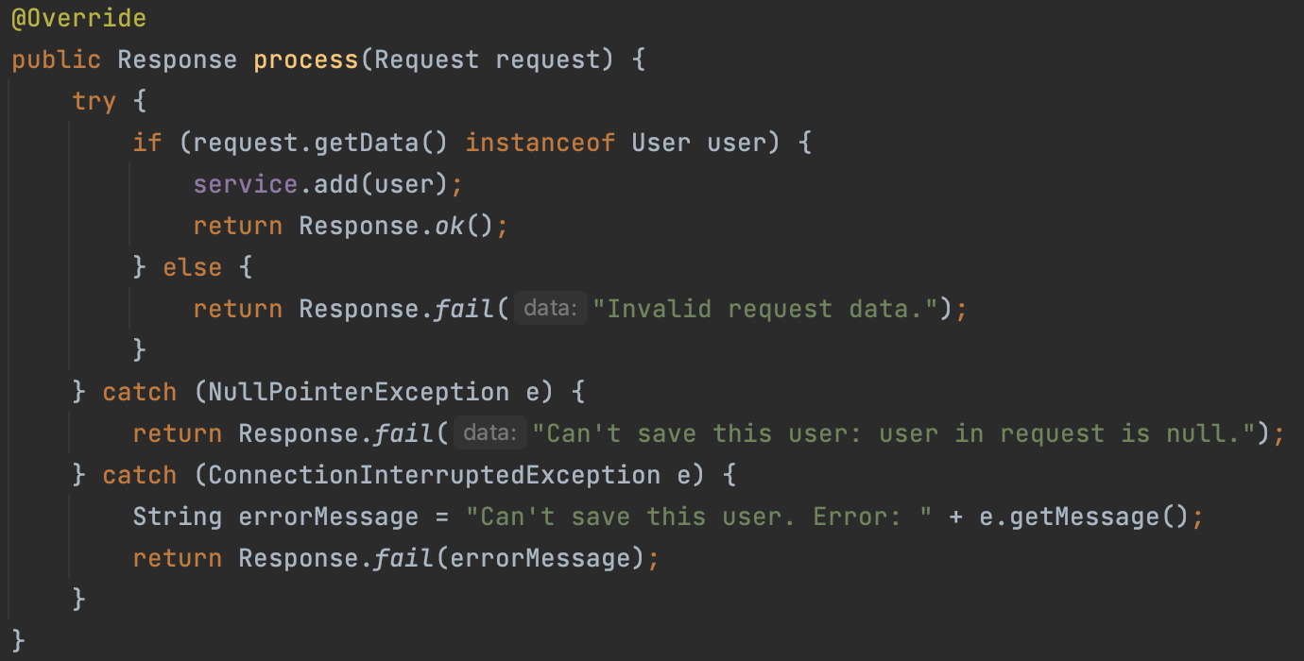
Fix the problems

Slide 11
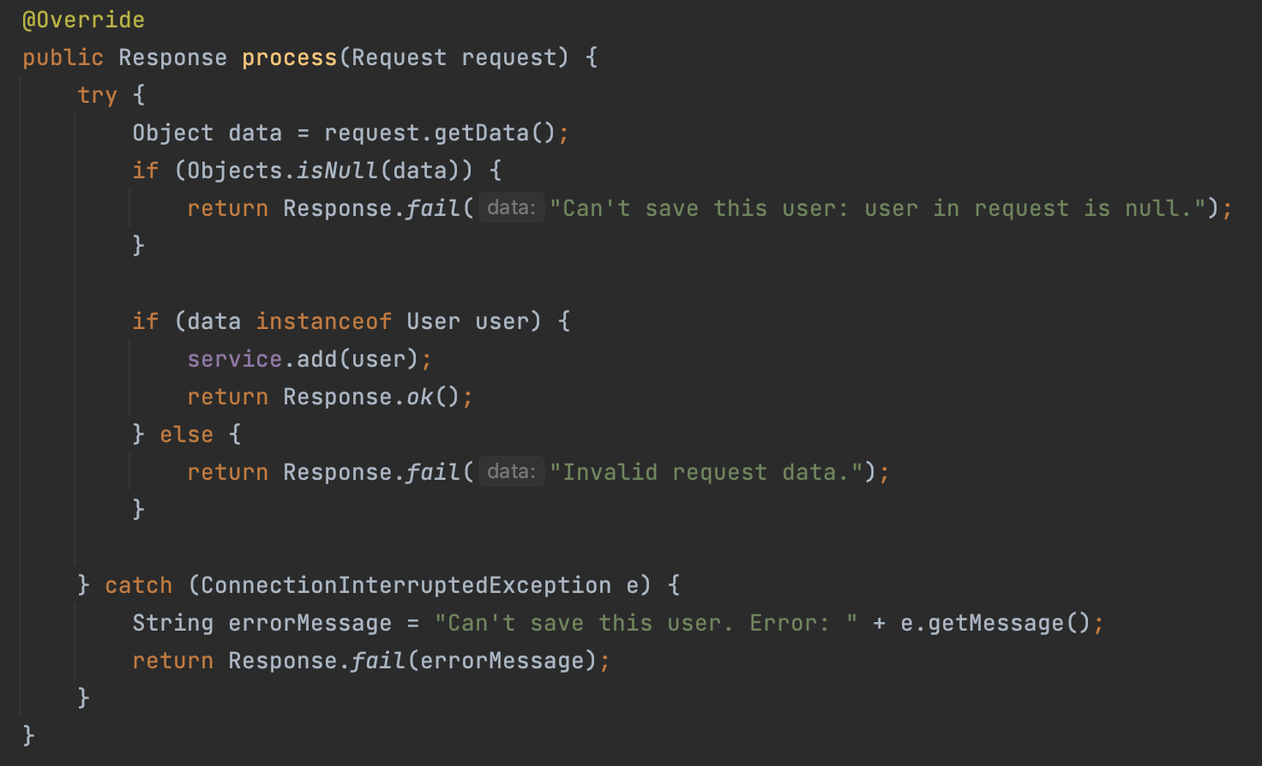
Fix the problems

Slide 12
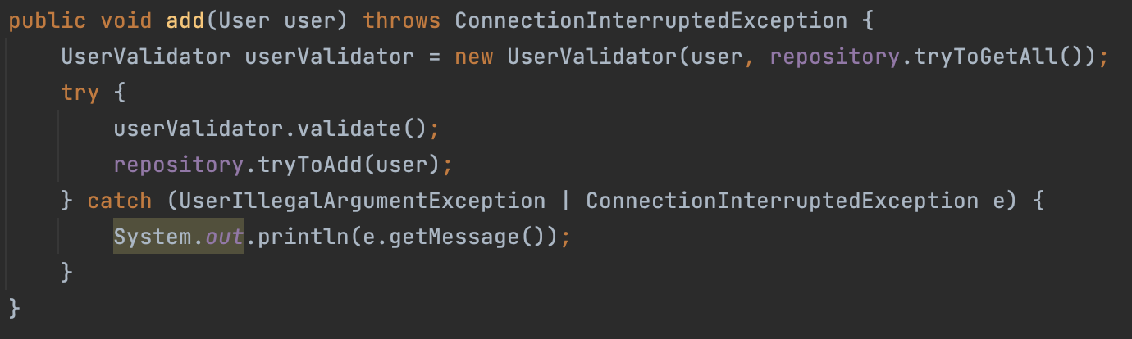
Do not scare consumer

Slide 13
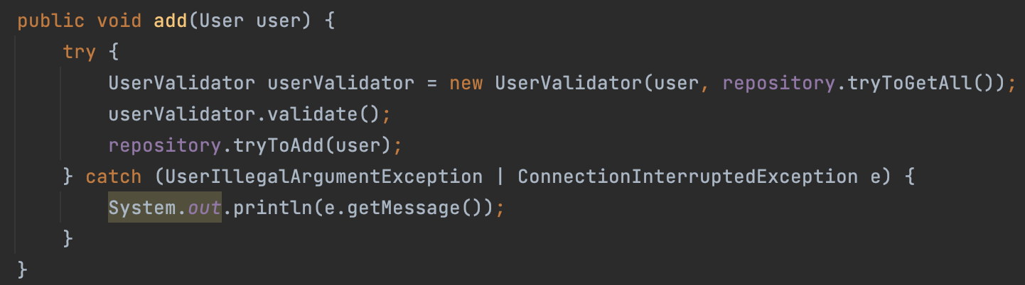
Do not scare consumer

Slide 14
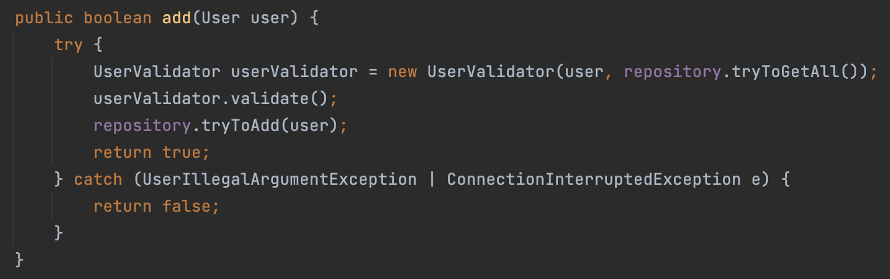
Do not scare consumer

Slide 15
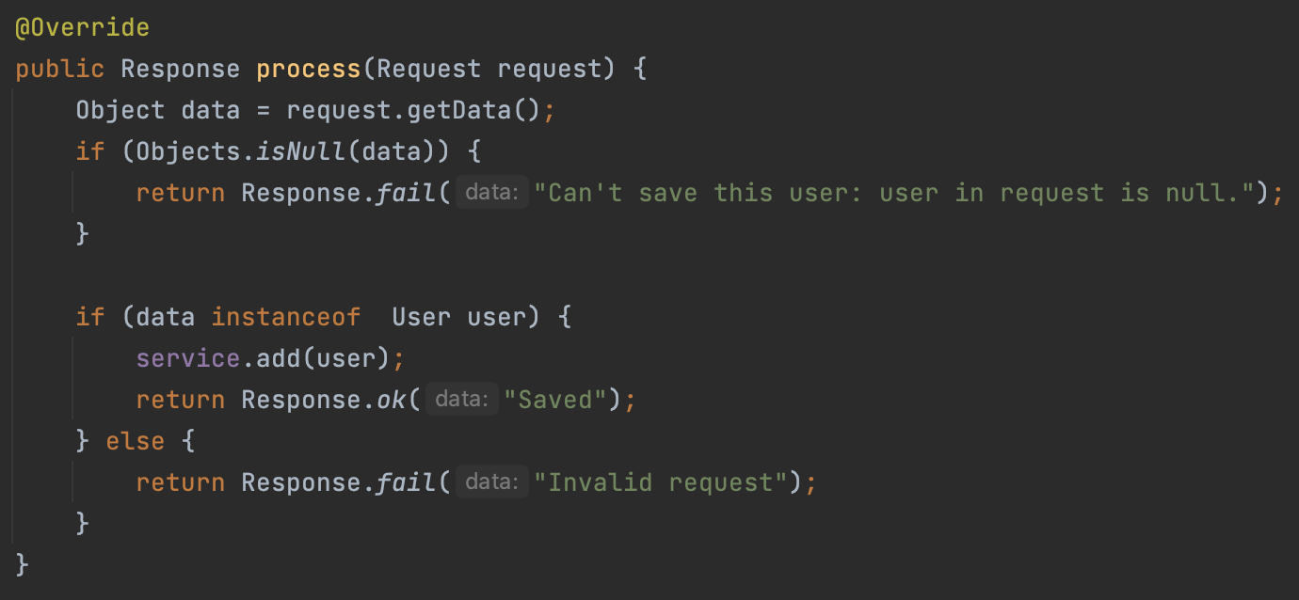
Fix the problems

Slide 16
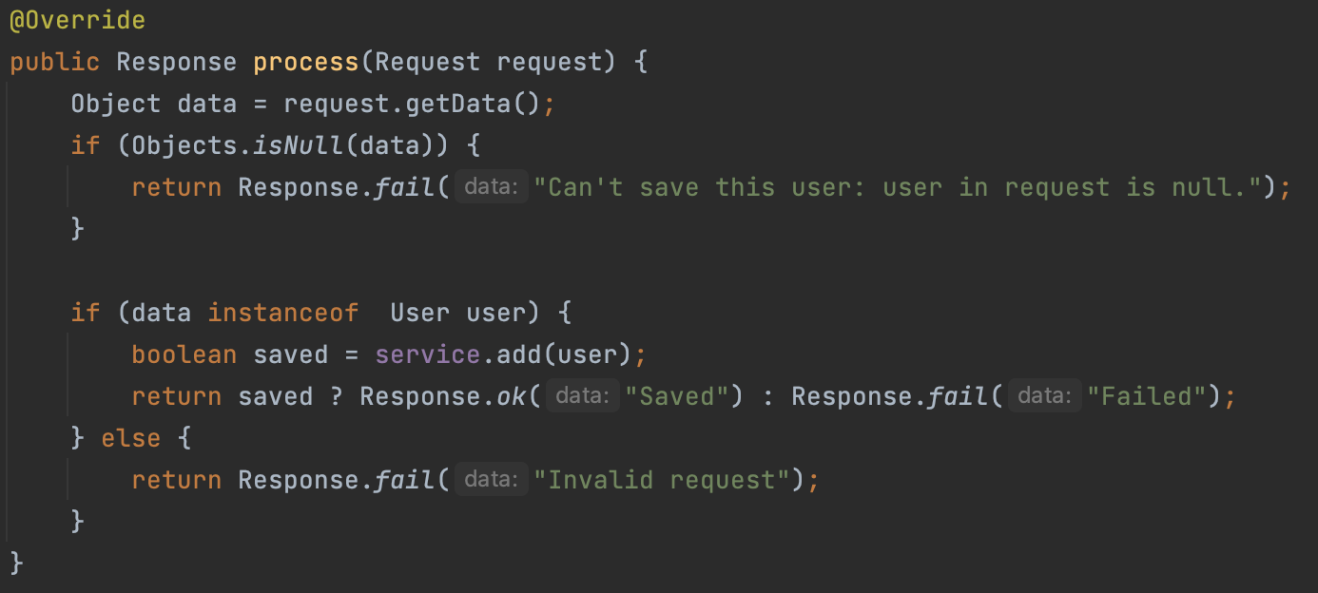
Fix the problems

Slide 17
Next homework assignment
Бодя:
Andrii Priadko
Dulskyi Ivan
Kateryna Chepurna
Olena Nemtsova
Vova Ponomarenko
Вова:
Artur Zaporozhets
Horbatko Ivan
Maks Savienkov
Valeriy Svetlichniy
Yahudin Kostiantyn
Влад:
Bohdan Lifirenko
Igor Shavlak
Oleg Furt
Sopilko Maxim
Yevhen Datsenko

Slide 18
That's all!
Find us in Slack:
@Bohdan Cherniak
@Vladyslav Nikolenko
@Volodymyr Vedula

